Slide 1

CSS
Lesson 12

Slide 2
CSS Pseudo Classes/Elements
What do the following mean in CSS?
Pseudo class Pseudo element
:link
:visited
...
:first-letter
:first-line
...

Slide 3
CSS Pseudo Classes/Elements
Selector | Example | Example description
:link | a:link | Selects all unvisited links
:visited | a:visited | Selects all visited links
:active | a:active | Selects the active link
:hover | a:hover | Selects links on mouse over
:focus | input:focus | Selects the input element which has focus
:first-letter | p:first-letter | Selects the first letter of every <p> element
:first-line | p:first-line | Selects the first line of every <p> element
:first-child | p:first-child | Selects every <p> elements that is the first child of its parent
:before | p:before | Insert content before every <p> element
:after | p:after | Insert content after every <p> element
:lang(language) | p:lang(it) | Selects every <p> element with a lang attribute value starting with "it"

Slide 4
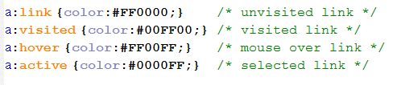
CSS Pseudo Classes/Elements
A PSEUDO-CLASS is way of selecting certain parts of a HTML document, based in principle not on the HTML document tree itself and its elements or on characteristics like name, attributes or contents, but on other phantom conditions like language encoding or the dynamic state of an element.

Slide 5
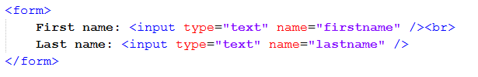

CSS Pseudo Classes/Elements
:focus
doc.html
style.css

Slide 6
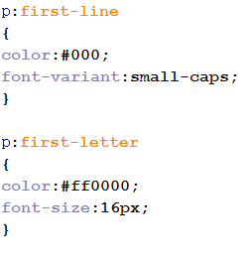
CSS Pseudo Classes/Elements
PSEUDO-ELEMENTS are used to address sub-parts of elements. They allow you to set style on a part of an element's content beyond what is specified in the documents.

Slide 7
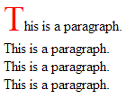
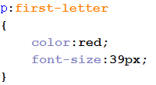

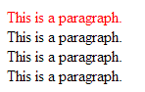

CSS Pseudo Classes/Elements
:first-letter , first-line
style.css
doc.html
style.css

Slide 8
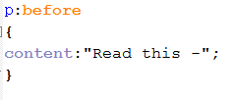




CSS Pseudo Classes/Elements
:before, after
style.css
doc.html
style.css

Slide 9
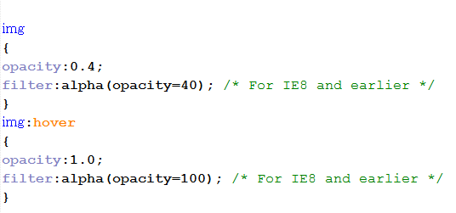
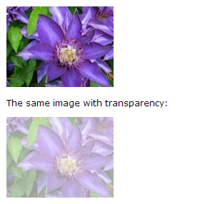
CSS Opacity
IE9, Firefox, Chrome, Opera, Safari
IE8 and earlier
opacity
filter:alpha(opacity=x).

Slide 10

CSS Box Shadow
The box-shadow property is supported in IE9+, Firefox 4, Chrome, Opera, and Safari 5.1.1.
h-shadow | Required. The position of the horizontal shadow. Negative values are allowed
v-shadow | Required. The position of the vertical shadow. Negative values are allowed
blur | Optional. The blur distance
spread | Optional. The size of shadow
color | Optional. The color of the shadow. Look at CSS Color Values for a complete list of possible color values
inset | Optional. Changes the shadow from an outer shadow (outset) to an inner shadow
box-shadow: h-shadow v-shadow blur spread color inset;

Slide 11

Task1:

Slide 12
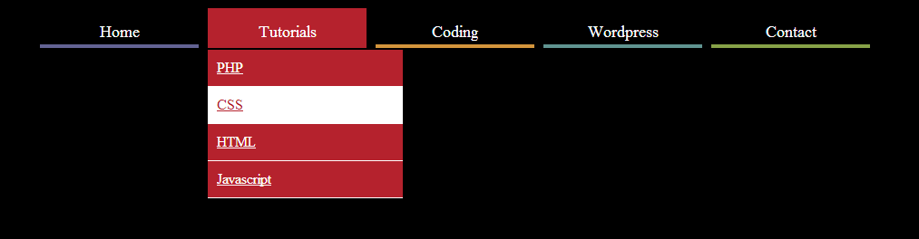
Task2:

